Slide 1
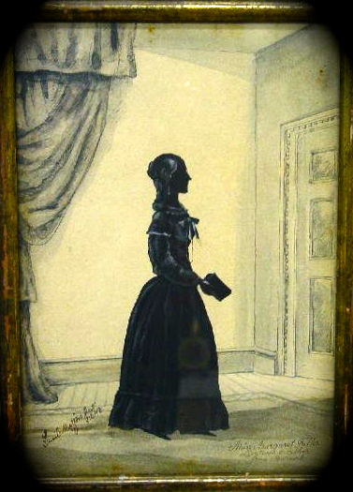
Margaret Fuller

Slide 2
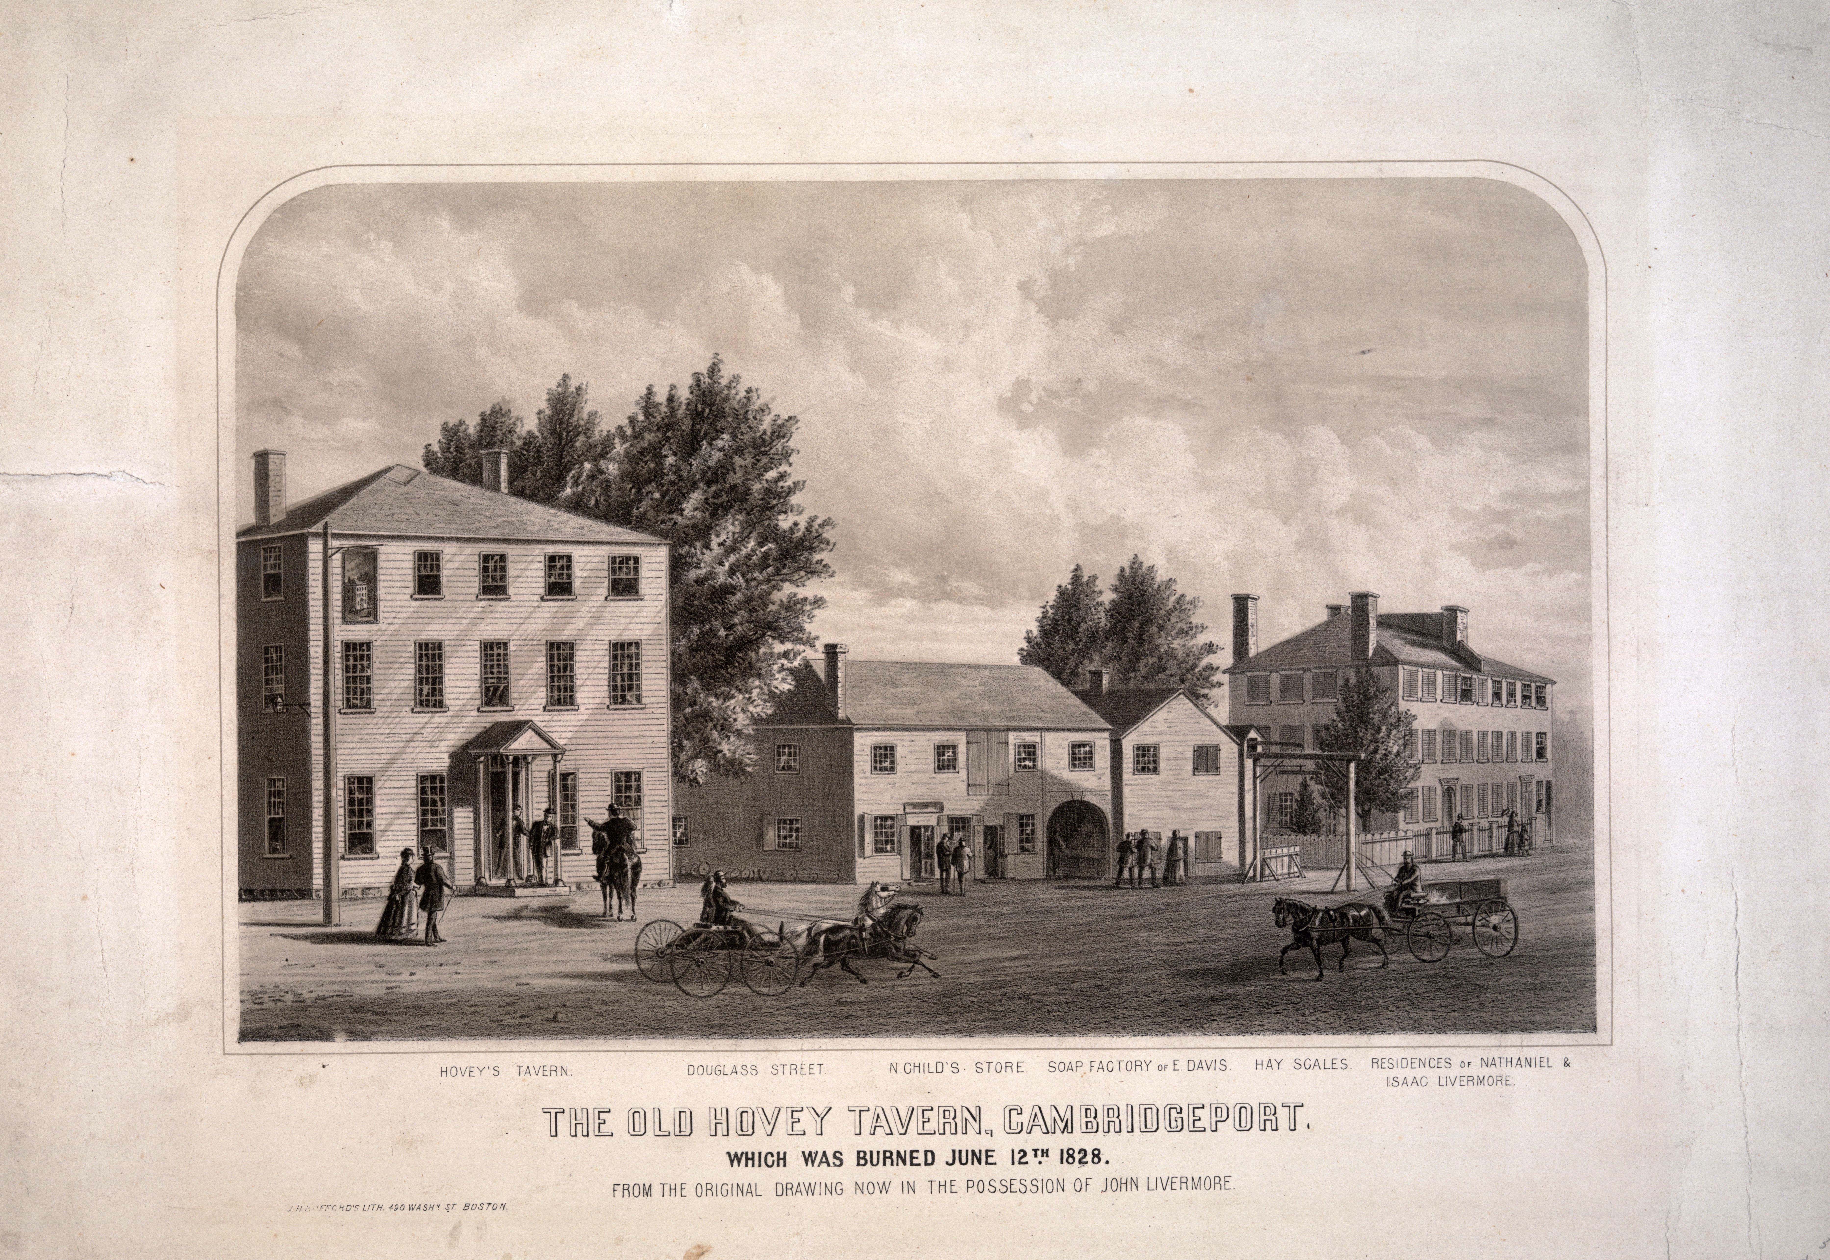

Slide 3
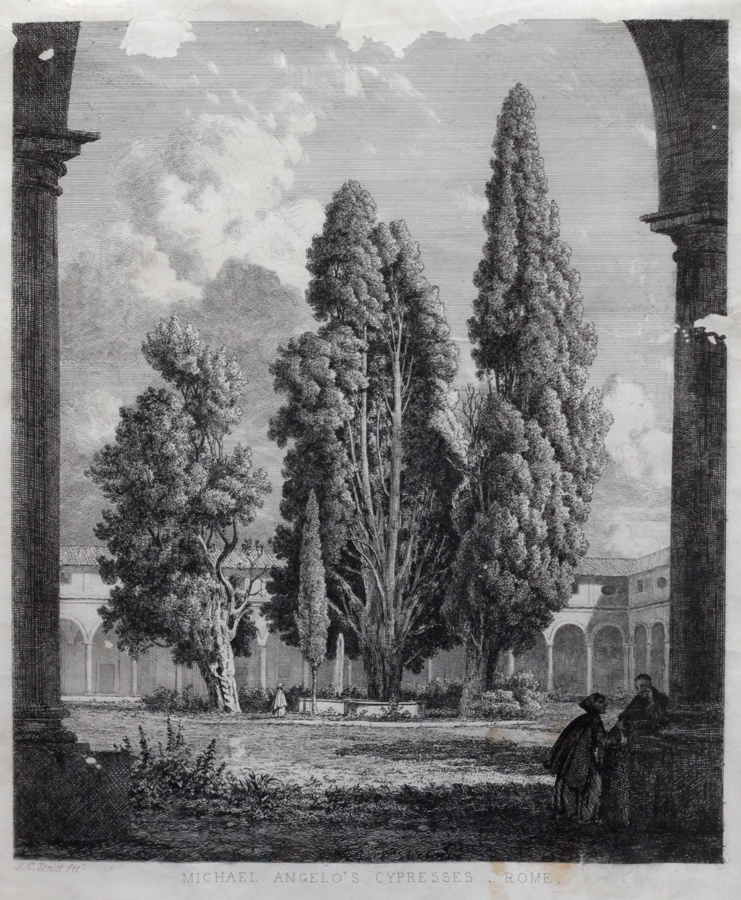
Michael Angelo’s Cypresses, Rome

Slide 4
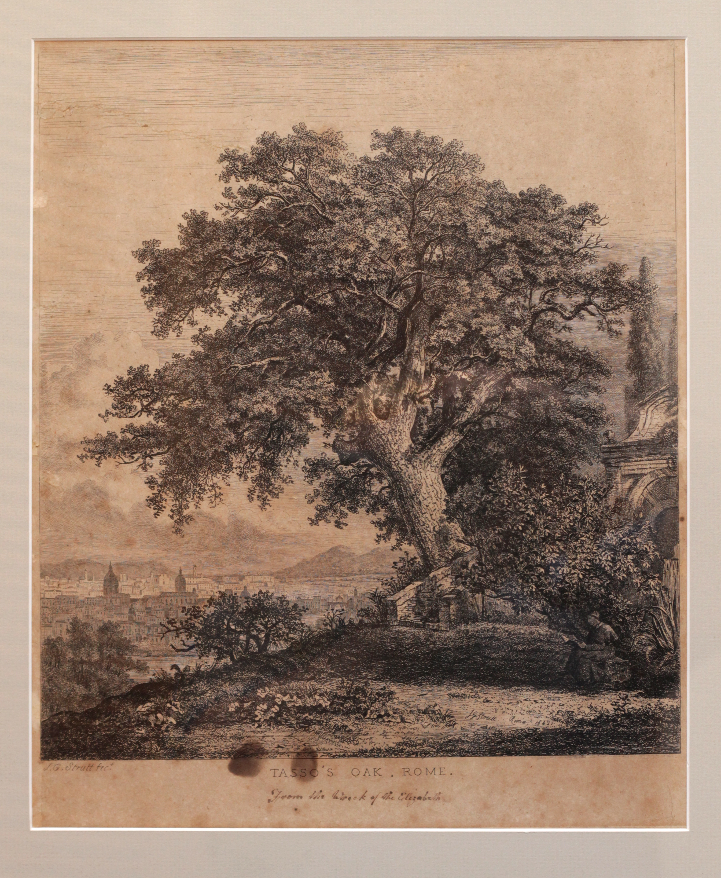
Tasso’s Oak, Rome

Slide 5
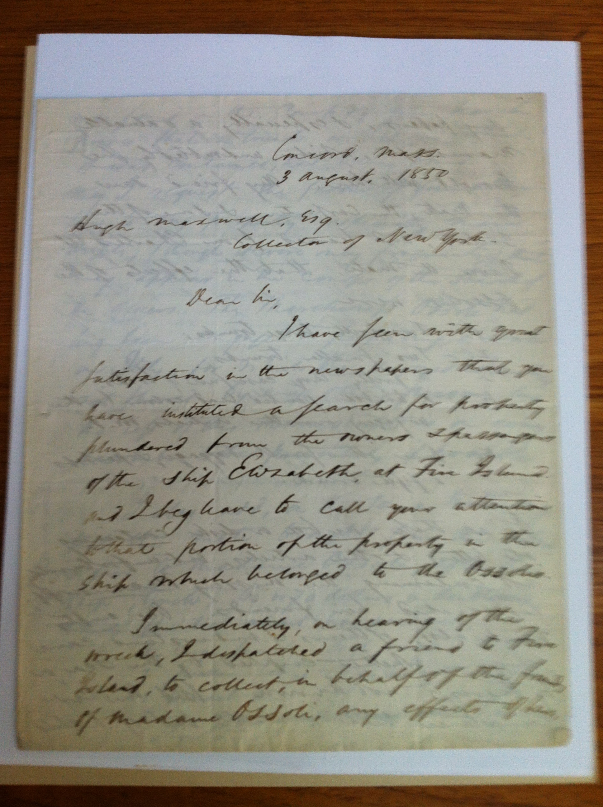
Concord, Mass.
3 August 1850
Hugh Maxwell, Esq.
Collector of New York
Dear Sir,

Slide 6
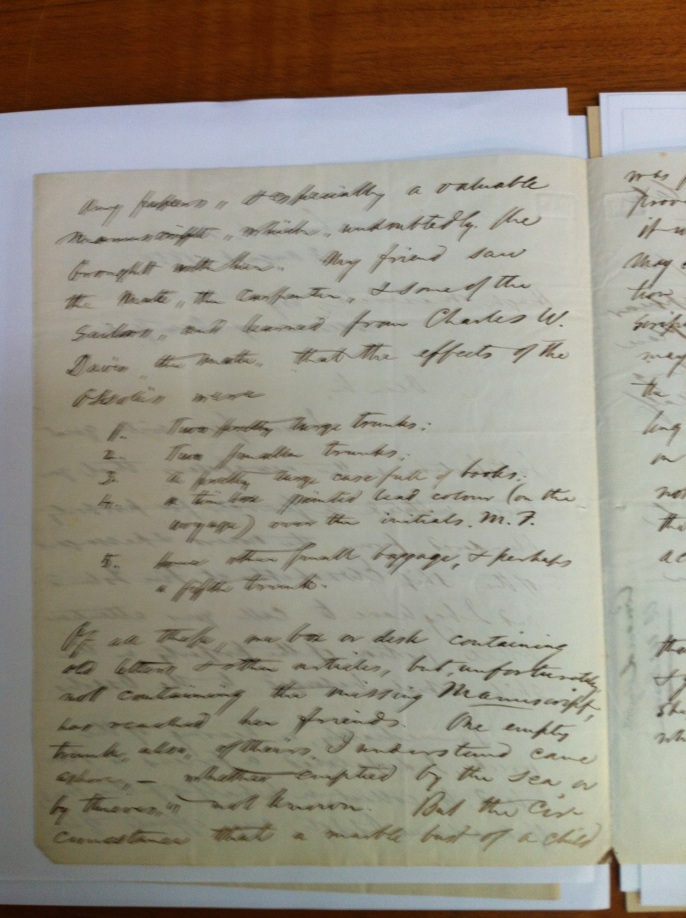

Slide 7
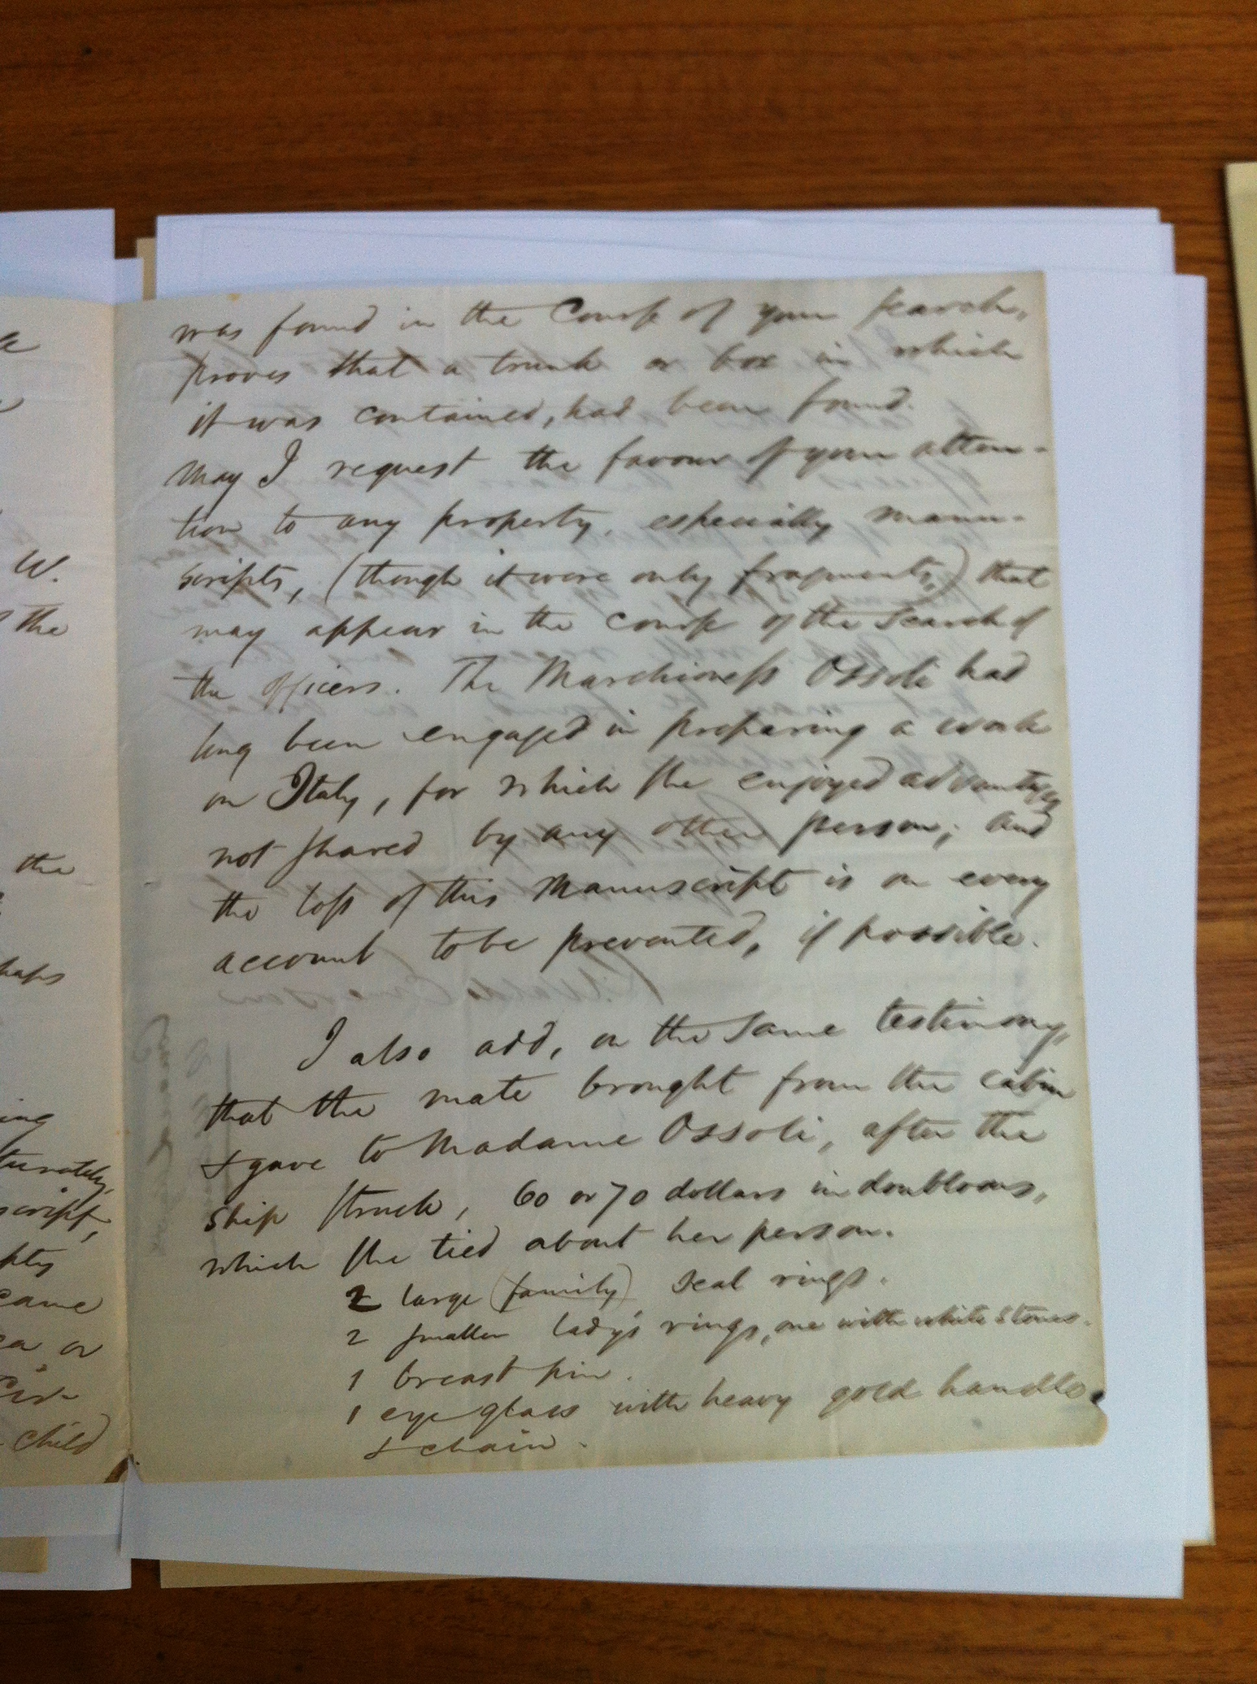

Slide 8
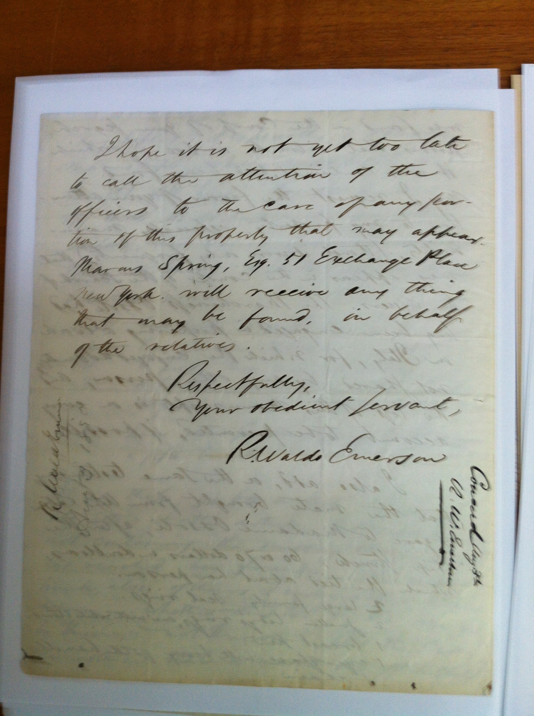
Respectfully,
Your obedient servant,
R. Waldo Emerson

